Slide 1
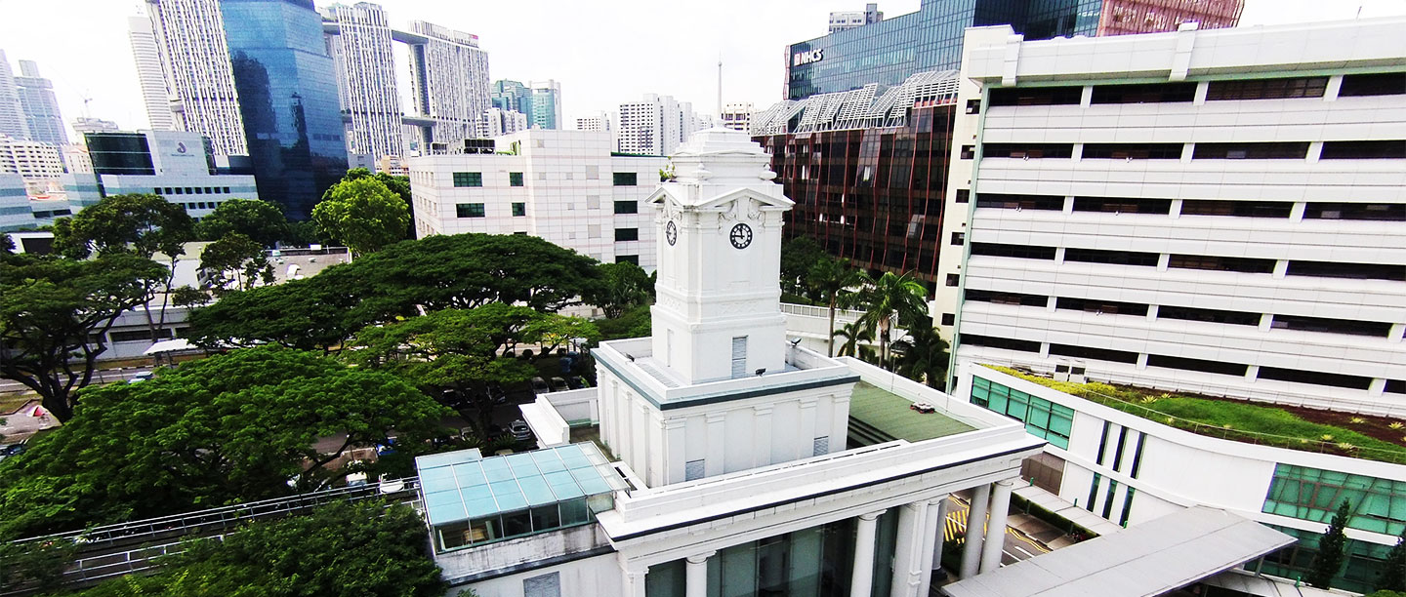

Restricted, Sensitive (High)
Restricted, Sensitive (Normal)
Unclassified
Restricted, Non-sensitive
MRI Prostate Segmentation Assistant (MRI PSA)
3 February 2026 (DDS Technical Meeting)
Anson – Analyst, Data Science
Sufyan – Associate Principal Analyst, Data Science
Move Fast & Make Things Together

Slide 2
Agenda
• Problem Statement & Clinical Need
• Project Objectives
• Solution Architecture
• Technical Implementation
• Integration & Deployment Strategy
• Preliminary Results
• Project Timeline & Next Steps

Slide 3
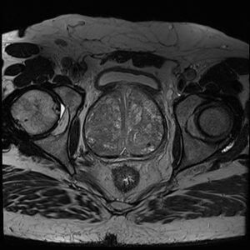
Problem Statement: Clinical Workflow Challenge
• SGH performs >1,700 prostate MRI examinations annually
• Approx. 42% proceed to MRI-guided targeted biopsy
• Current biopsy planning workflow is highly manual:
‣ Manual prostate and lesion contouring in vendor software
‣ Takes ~16 minutes per case
‣ Requires expertise and is time-consuming
• Multiple manual transfer steps introduce potential errors
• Opportunity: AI-assisted contouring to improve efficiency
Notes:
- To set the context: SGH performs more than 1,700 prostate MRI exams annually, and about 42% of these proceed to MRI-guided targeted biopsy. - Today, the biopsy planning workflow is still highly manual — radiologists do manual prostate and lesion contouring in vendor software, which takes ~16 minutes per case - On top of that, there are multiple manual transfer steps, which adds time burden and increases the potential for human error in multi-step preparation - So the opportunity is straightforward: build an AI-assisted contouring workflow that generates DICOM-compliant segmentations quickly, to improve efficiency while keeping radiologists in the loop for review and final responsibility

Slide 4
Project Objectives
Primary Goals
Integration Goals
• Develop AI-assisted prostate segmentation workflow
• Reduce contouring time from ~16 min to ~5 min
• Generate DICOM-compliant outputs (RTSTRUCT)
• Train SGH-optimized model using local data
• Preserve clinical quality through radiologist review
• Integrate with RAPIER CARPL platform
• Ensure compatibility with Biobot systems
• Mona Lisa surgical biopsy system
• UroFusion contour review software
• Seamless end-to-end clinical workflow
TLDR; Our job is to output DICOM-compliant RTSTRUCT segmentations that these tools can ingest reliably for surgical planning and hopefully reduce the tedious and manual biopsy planning workflow to just 5 minutes per case!
Notes:
-the core aim is to develop, integrate, and trial deploy an SGH-trained prostate segmentation assistant for prostate mpMRI that improves workflow efficiency, while preserving clinical quality through radiologist review
- On the primary goals: we’re building an AI-assisted contouring workflow that generates DICOM-compliant segmentation outputs (RTSTRUCT), with a stated success target to reduce contouring time from ~16 minutes to ~5 minutes per case under radiologist oversight. - On the model strategy: we plan to train using SGH historical prostate MRI data, accelerating annotation by using an available open-source model to generate initial contours, then having radiologists refine them to curate the local dataset - On integration goals: the deployment path is through RAPIER CARPL into SGH clinical workflows, and the outputs must be compatible with Biobot’s ecosystem — specifically their UroFusion software and Mona Lisa targeted biopsy system.

Slide 5
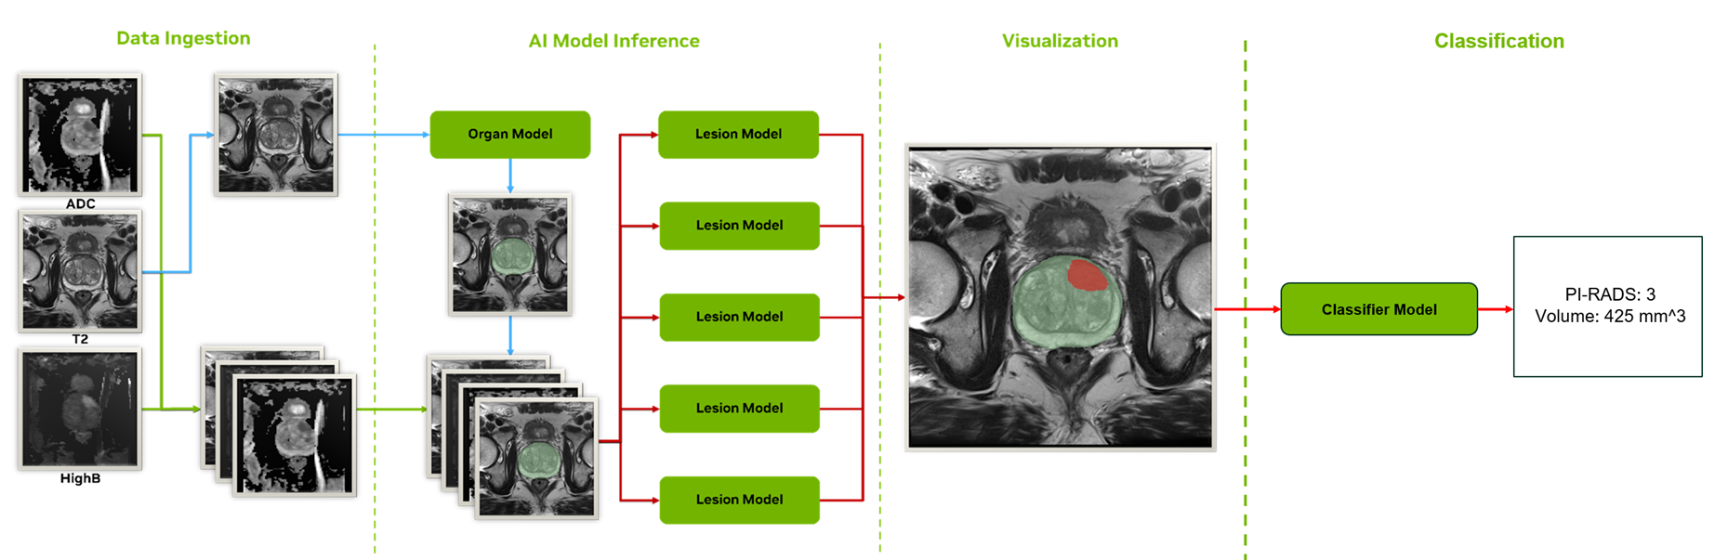
Solution Architecture: End-to-End Pipeline
MONAI Deploy DAG: DICOM Ingestion → Organ Segmentation → Lesion Segmentation → PI-RADS Classification → RTSTRUCT Export
Notes:
- This is the end-to-end MONAI Deploy DAG we’re implementing: it ingests a prostate mpMRI DICOM study, then runs organ segmentation → lesion segmentation → PI-RADS classification → exports RTSTRUCT for downstream clinical use. - On the left is data ingestion + series selection: the pipeline auto-selects T2, ADC, and HIGHB using curated regex rules on DICOM tags like Modality, ImageType, SeriesDescription - For organ segmentation, we preprocess T2 only — reorient to RAS, resample to 1.0 mm isotropic, then run sliding-window inference to produce a multi-class prostate mask (TZ/PZ) - That organ mask then constrains the lesion stage: ADC/HIGHB are aligned to T2 geometry, everything is resampled to 0.5 mm isotropic, and we crop an ROI around the prostate with a 32-voxel margin before running a 5-fold 3D RR-UNet ensemble and applying a fixed threshold to get the final lesion mask - Finally, for classification, we extract 64×64×64 crops around each lesion component and run a 3D ResNet classifier to map outputs into PI-RADS 2–5, with a documented size-based adjustment rule - Outputs are deliberately audit-friendly: NIfTI copies of selected inputs, organ/lesion masks and probability maps, a lesion YAML report, and the two RTSTRUCT DICOM files (organ + lesion)

Slide 6
Technical Implementation: Data Pipeline
• Multi-parametric MRI Inputs (mpMRI):
‣ T2-weighted (anatomical detail)
‣ ADC map (diffusion-derived)
‣ High b-value DWI (lesion detection)
• Automated Series Selection:
‣ Regex-based DICOM tag matching (Modality, ImageType, SeriesDescription)
‣ Robust across ProstateX and common site naming conventions
• Standardization Pipeline:
‣ RAS orientation alignment
‣ Isotropic resampling (1.0mm organ, 0.5mm lesion)
‣ Per-channel z-score normalization
• Output Generation:
‣ NIfTI volumes for reproducibility
‣ Multi-class masks
‣ DICOM RTSTRUCT for clinical integration

Slide 7
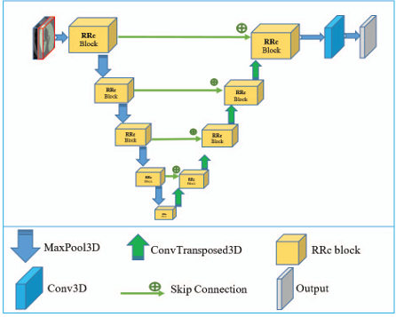
RRUNet3D - Residual Recurrent UNet for 3D Medical Image Segmentation
RRUNet3D is a U-Net variant that combines residual connections and recurrent convolutions for improved feature learning in 3D medical image segmentation.
Key Components
Residual Blocks
Improves gradient flow: x + Conv(Conv(x))
Recurrent Blocks
Iterative refinement: x1 = Conv(x + x1)
Skip Connections
Preserve spatial details across levels
Attention Gates
Focus on relevant features (optional)
Notes:
Input Conv: Downsample by 2x, expand to 32 channels
Encoder: 4 levels with max pooling, channels double each level (32→64→128→256)
Decoder: 3 levels with upsampling + skip concatenation
Output: 1×1 conv to target classes → Softmax
Why RRUNet for Prostate MRI?
3D native: Processes volumetric MRI directly (not slice-by-slice)
Multi-scale features: Encoder-decoder captures both local texture and global context
Flexible: Can toggle recurrent/attention/SE modules based on task complexity
Proven: Based on architectures validated in medical imaging literature

Slide 8
Forward Pass: From MRI to Segmentation
High-Level Pipeline:
Raw MRI
Learn Features
Understand Context
Precise Localization
Segmentation
→
→
→
→
5 Key Steps:
1
Input Conv
Downsample 2x, expand to 32 channels
→ Extracts initial features
2
Encoder
4 levels, progressively compress
→ Builds hierarchical understanding
3
Skip Connections
Save encoder features
→ Preserves fine spatial details
4
Decoder
3 levels, progressively reconstruct
→ Combines 'what' with 'where'
5
Output
1x1 conv + Softmax
→ Per-voxel class probabilities

Slide 9
Complete Architecture: Visual Summary
ENCODER
DECODER
Input [T2,ADC,HIGHB]
L1-32ch
L1-32ch
Output Conv
Segmentation Mask
→
───────────────────→ skip 1
→
→
L2-64ch
─────────────────→ skip 2
L2-64ch
L3-128ch
────────────→ skip 3
L3-128ch
L4-256ch
↗
BN
Key Insights:
Encoder learns 'WHAT'
— progressively understands: pixels → textures → shapes → organs
Decoder learns 'WHERE'
— reconstructs precise spatial boundaries from abstract features
Skip connections bridge both
— combines semantic understanding with spatial precision

Slide 10
Why RRUNet3D for Prostate MRI?
Challenge
How RRUNet Solves It
Small lesions (few mm)
Multi-scale encoder detects features at different sizes
Fuzzy tissue boundaries
Skip connections preserve edge information
3D spatial relationships
Native 3D convolutions (not slice-by-slice)
Multiple tissue types
Multi-channel input captures complementary contrast
Class imbalance
Softmax + Dice loss ensures all classes predicted
Need for robustness
5-fold ensemble averages out individual model errors
Summary: RRUNet3D is designed for the specific challenges of 3D medical image segmentation - it captures multi-scale features, preserves spatial precision through skip connections, and processes volumetric data natively.

Slide 11
Stage 1: Organ Segmentation
Architecture
Processing Pipeline
• Input: T2-weighted MRI
• Model: RRUNet3D (Residual Recurrent)
• Output: 3-class segmentation:
• - Background (0)
• - Transition Zone - TZ (1)
• - Peripheral Zone - PZ (2)
• Resolution: 1.0mm isotropic
• Inference: Sliding window (128×128×16)
• Overlap: 50%, Gaussian blending
• Preprocessing:
• - Channel-first tensor format
• - RAS orientation
• - 1.0mm isotropic resampling
• - Z-score normalization
• Post-processing:
• - Softmax activation
• - Argmax with threshold=None
• - Multi-class mask preservation

Slide 12
Stage 2: Lesion Segmentation (5-Fold Ensemble)
Architecture
Design Rationale
• Input: T2 + ADC + HIGHB (3 channels)
• Model: 5-fold RRUNet3D ensemble
• Output: Binary lesion mask
• Resolution: 0.5mm isotropic
• ROI Cropping: Organ mask + 32-voxel margin
• Parallel inference across folds
• Probability averaging + thresholding
• Key Design Decisions:
• - Multi-parametric input captures
• complementary tissue properties
• - Ensemble improves robustness
• - Organ-masked inference reduces
• false positives outside prostate
• Threshold: 0.6345 (optimized)
• Post-multiply by organ mask

Slide 13
Stage 3: PI-RADS Classification
• Model: 3D ResNet (BasicBlock, [32,64,128,256] channels)
• Input: 64×64×64 crops centered on each lesion
• Output: 4-class prediction → PI-RADS 2, 3, 4, 5
• Rule-based Adjustment:
‣ If predicted PI-RADS 4 AND major axis > 40mm → Upgrade to PI-RADS 5
‣ Aligns with clinical size criteria for significant lesions
• Final Report (lesions.txt):
‣ Per-lesion: ID, PI-RADS score, major axis (mm), volume (mm³)
‣ Organ statistics for context

Slide 14
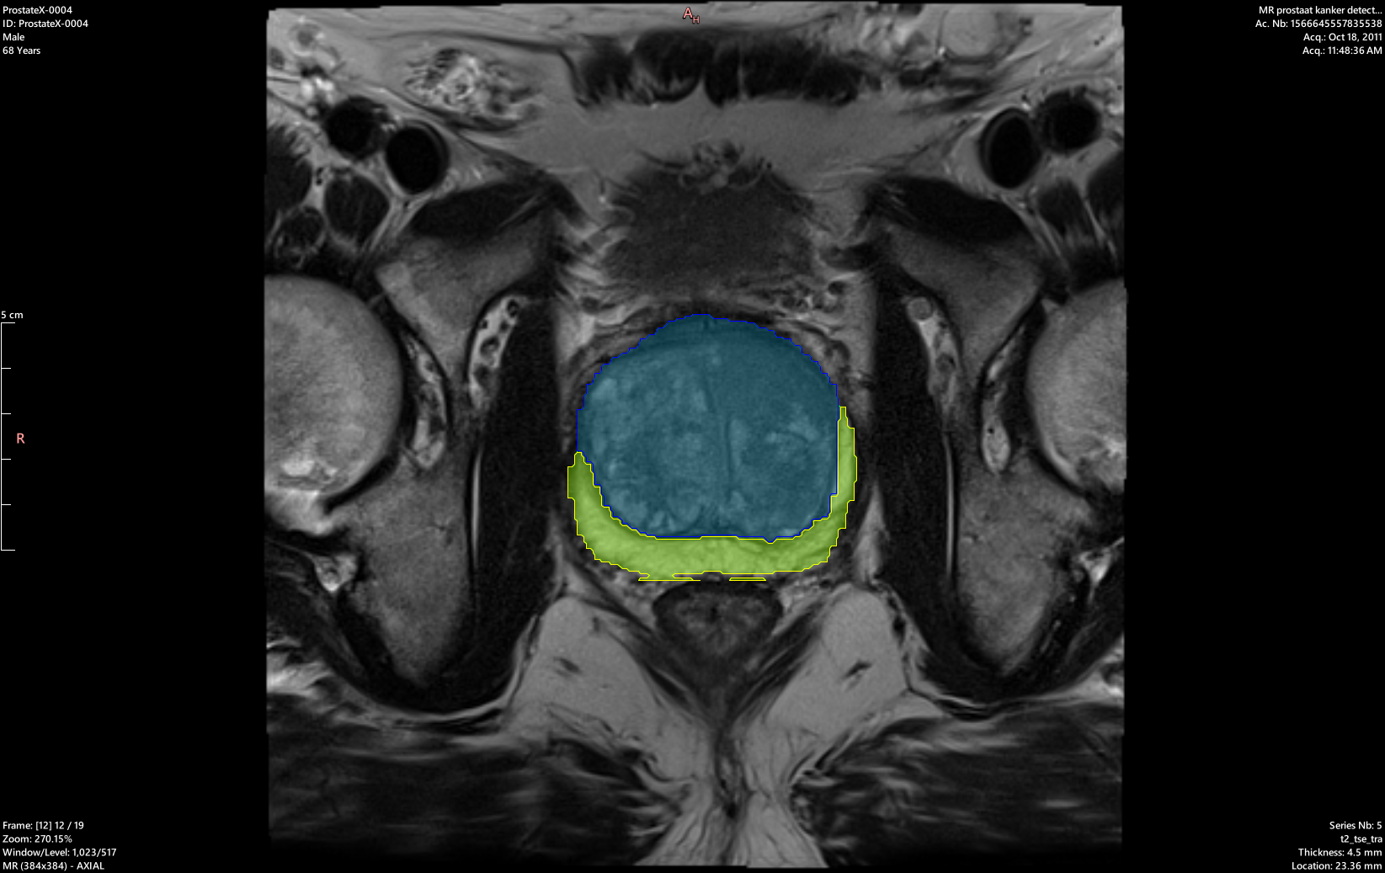
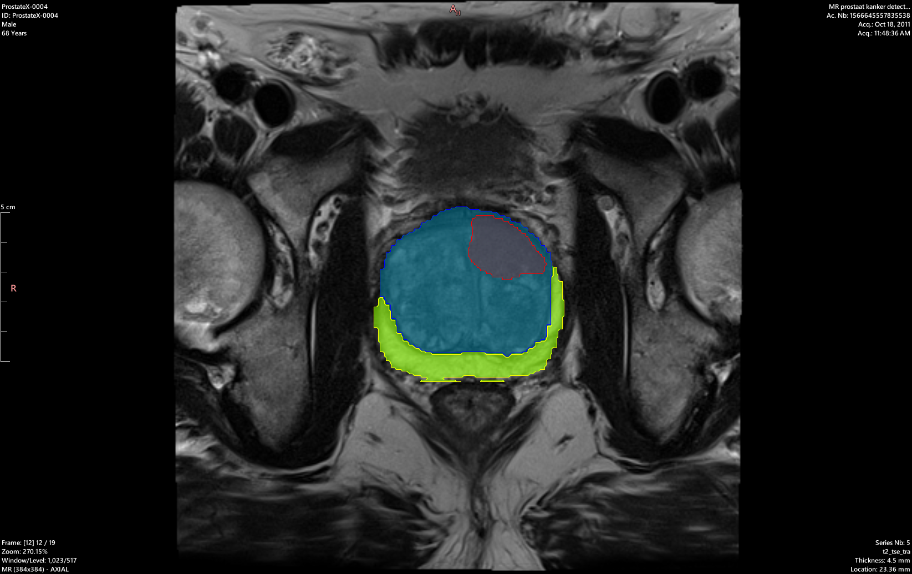
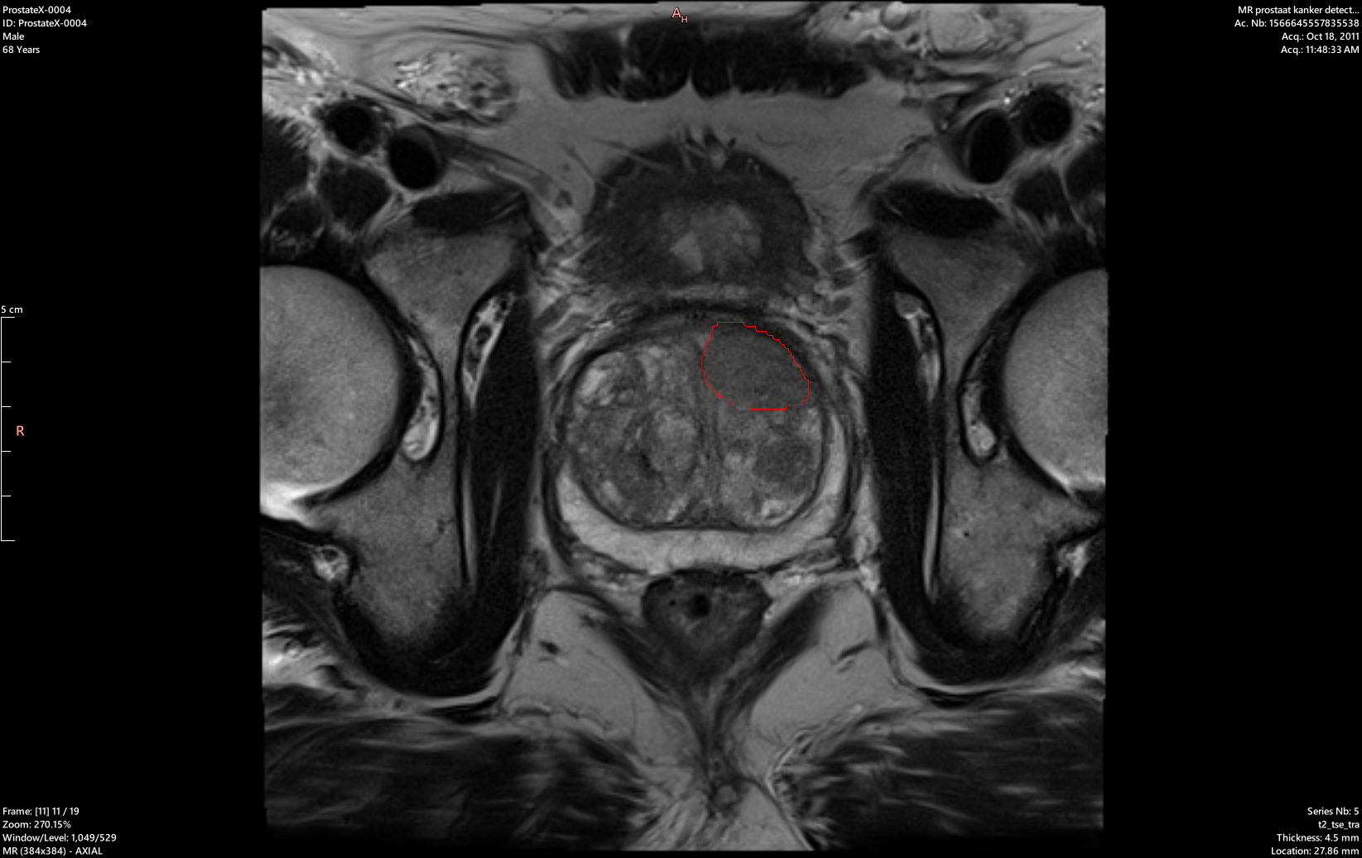
Segmentation Output Visualisation
Organ Segmentation (TZ/PZ)
Validation DICE: 0.76
Combined View (Organ + Lesion)
Lesion Detection
(RTSTRUCT Format)
Validation DICE: 0.36

Slide 15
Preliminary Results (Open-Source Data)
Quantitative Metrics
Development Status
Organ Segmentation (TZ/PZ):
Fold-0 Dice: ~0.73
Multi-fold average: ~0.73-0.80
RTSTRUCT export verified on ProstateX
3D Slicer overlap validation passed
Lesion Segmentation:
5-fold ensemble implemented
RRUNet3D
Organ-masked inference reduces FP
Approx 0.36
Important Note:
Results on open-source data only
SGH clinical data training pending

Slide 16
Project Timeline (SGH Innovation Grant 2025)
Oct 2025
IRB Exemption
COMPLETED
Dec 2025
Establish Partnership Agreement
COMPLETED
Jan 2026
SGH Data Extraction
IN PROGRESS
Jan 2026
Onboard NIH Model to CARPL
IN PROGRESS
Mar 2026
Biobot UroFusion Import Capability
PLANNED
Jun 2026
Generate & Refine Contours (Dataset)
PLANNED
Aug 2026
Train SGH-Optimized Model
PLANNED
Sep 2026
Trial Deployment
TARGET

Slide 17
Next Steps & Action Items
Development Roadmap
Success Criteria
Immediate (Jan-Mar 2026):
• Complete SGH data extraction
• Deploy NIH baseline on CARPL
• Validate series selection on SGH data
• Establish radiologist annotation workflow
Short-term (Mar-Jun 2026):
• Biobot UroFusion integration
• Generate preliminary contours
• Radiologist refinement (curated dataset)
Medium-term (Jun-Sep 2026):
• Train SGH-optimized model on CHROMA
• Validate on held-out test set
• Performance benchmarking
Target Outcomes:
• Contouring time: 16 min → 5 min
• Seamless PACS integration
• Radiologist-approved contours
• Trial deployment by Sep 2026

Slide 18


Thank You

